Slide 1

FAKE NEWS
Zero Shot Fake News Detection
Asmita Mukherjee
Hanzalah Firdausi
Harsh Vardhan Bhadauriya
Shreyansh Jain
Sehban Fazili
Group no 18

Slide 2

Motivation
The rise of social media has amplified the potential impact of misinformation.
There has been significant investment, totaling over $300 million, from major media and tech organizations to combat fake news, along with support from various activists, NGOs, and interest groups.
The prevalence of fake news and disinformation continues to grow, affecting millions of individuals globally, highlighting the necessity of implementing a solution.
The persistent spread of inaccurate information calls for a technology-based approach to eradicate it from the internet.
To address this issue, we introduce this tool which checks the trustworthiness of the news articles.

Slide 3

Problem Statement
The objective of this project is to create a tool for checking whether news articles are trustworthy or not.
The tool will have to perform an evaluation of the facts, events, and related information within a news article.

Slide 4
Literature Review
The field of fake news detection is expanding rapidly, and a plethora of research has been conducted on this topic. Notable works in this area include:
"Fake News Detection on Social Media: A Data Mining Perspective" by Shu et al. (2017): This paper proposes a framework for detecting fake news on social media using data mining techniques.
"Combating Fake News: A Survey on Identification and Mitigation Techniques" by Zubiaga et al. (2018): This survey paper provides an overview of various techniques that have been proposed for detecting and mitigating fake news.
"Detection of Fake News in Social Media: A Machine Learning Approach" by Babalola et al. (2019): This paper presents a machine learning-based approach for detecting fake news on social media.
"A Survey on Fake News: Detection, Analysis, and Mitigation Techniques" by Singh et al. (2020): This survey paper provides an in-depth analysis of various detection, analysis, and mitigation techniques for fake news.
"Fake News Detection on Social Media using Geometric Deep Learning" by Pham et al. (2021): This paper proposes a novel approach for detecting fake news on social media using geometric deep learning.

Slide 5
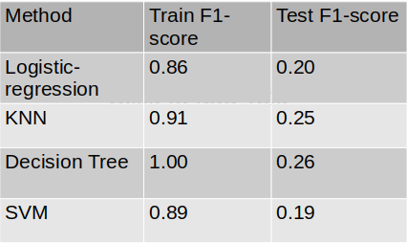
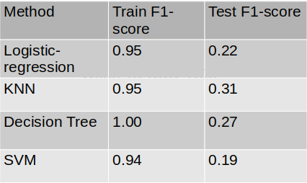
Baseline Results
TF-IDF vectorization with ML classifier
BERT embeddings with ML classifier

Slide 6
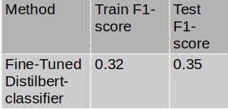
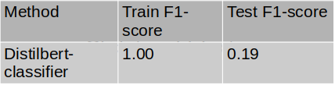
Baseline Results
Fine-Tuned BERT Classifier
BERT Classifier

Slide 7
Novelty
Since the method is zero-shot , it can classify news article almost instantaneously, while other machine learning and deep learning methods require additional training time.
Zero-shot method performs really well on unseen classes.
Dataset need not be annotated. Unsupervised approach.
As seen before in our baselines , methods which require training work well when the test set is from similar domain, however since our method relies on question answering, it generalizes across different domains.

Slide 8
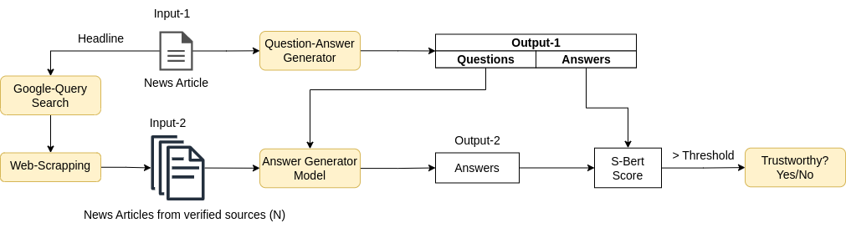
Model Architecture/Pipeline

Slide 9

Proposed Solution
We propose a two step solution:
Question-Answer generation
Answer generation task
The Question Answer Generator will be utilized to generate questions and answers from a given input news article.
The verified news articles will be retrieved by conducting a reverse text search on credible and reputed news websites, focusing on a specific topic.
The pre-trained answer generation model will then be used to generate answers to the questions generated by the QA Generator, using the trustworthy news article as context.
The answers from the input news article will be compared with the answers from the credible sources using evaluation metrics.
Based on the results of this comparison, a determination will be made as to whether the news article is trustworthy or not, using a set threshold.

Slide 10
Question-Answer Generator
Answer Generation Model
The QA Generator is used to produce questions and answers from input news articles.
A DistilBERT model, fine-tuned on the SQuAD dataset, is employed to generate answers to the questions using the verified news articles as context.
The Question and Answers are generated using an answer-aware question generation model, which has been fine-tuned using the t5-base model.
We give the questions generated from the QA generator on the input news article as an input and the verified news articles as context to the answer generation model to generate answers.

Slide 11
How Question-Answers are generated?
We use one such example using DistilBert Question-Answer generator model.
Input Text - While on the campaign trail, Donald Trump promised to revive the coal industry and after he took power, he signed an executive order rolling back a temporary ban on mining coal and a stream protection rule that was imposed by the Obama administration.
Question-Answer Pair: { 'question': "What did Donald Trump's executive order roll back after he took power?", 'answer': 'a temporary ban on mining coal and a stream protection rule that was imposed by the Obama administration'},

Slide 12
Evaluation Metrics
The metrics that can be used to evaluate the similarity between the answers of the input news article and the verified news article are as follows:
Bleu score
Rouge score
SentBERT
The threshold can be set by experimenting with the model.

Slide 13
S-Bert Score Distributions

Slide 14
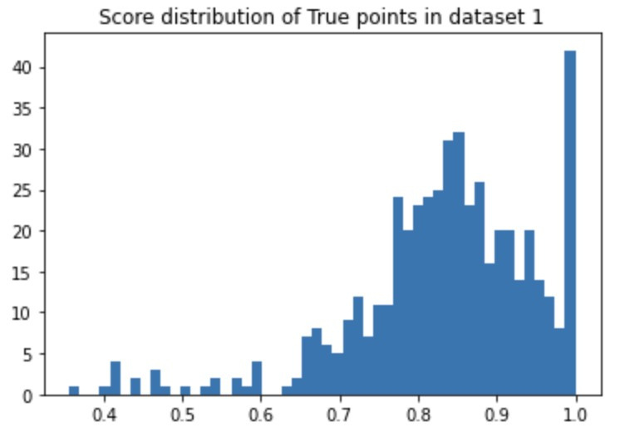
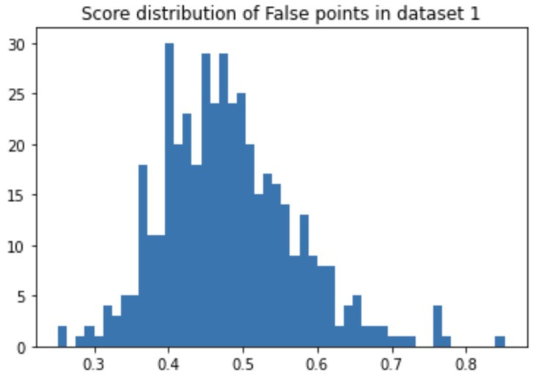
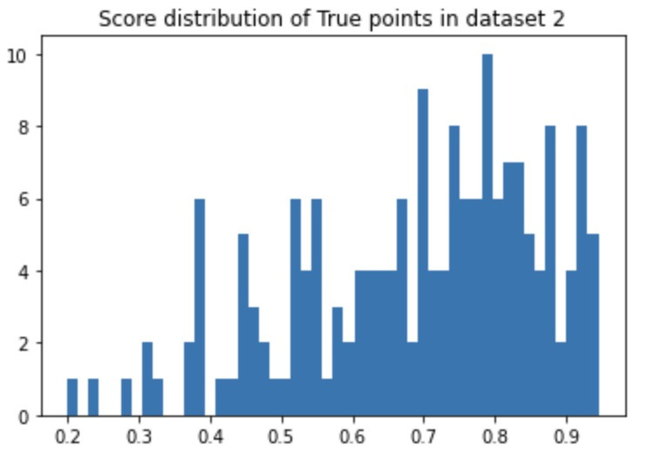
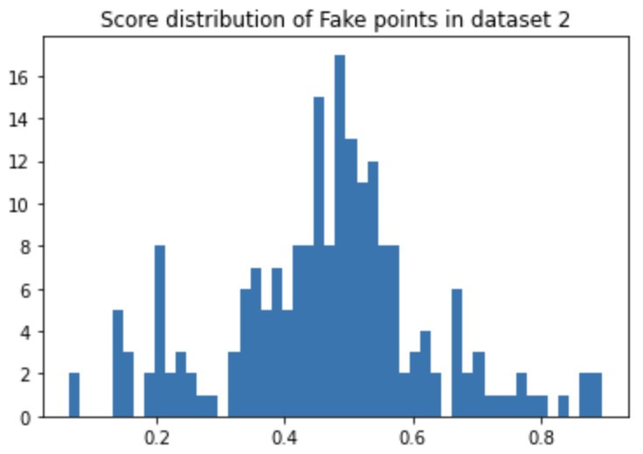

Slide 15
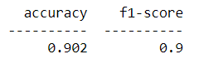
Combined Results
The results shown here are based on the combined Datasets:
Fake and True News dataset (Dataset-1)
Fake News detection dataset (Dataset-2)
The threshold after experimenting was set at 0.65 and the results are as follows:

Slide 16
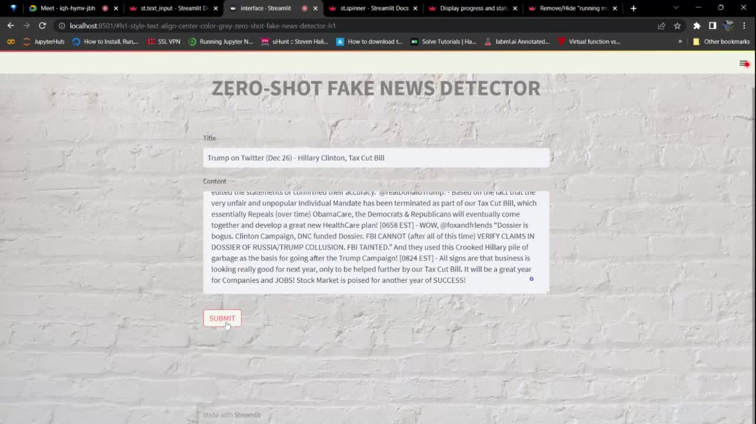

Slide 17
Challenges
When scraping data from websites, we found that there is a limit to the number of requests that can be made before the website blocks further requests. This can hinder data collection and slow down the research process.
Deploying websites with pre-trained models can make the website slow and less responsive. This is because these models can be quite large and computationally expensive, which can cause delays in processing and returning results to users.
We also experienced issues with too many dependencies, which can make the project difficult to manage and maintain. Installing and updating multiple packages can be time-consuming and lead to compatibility issues, which can cause errors and bugs in the code.
The approach is limited to text input only.

Slide 18
Future Works
Predicting news based on the article's URL rather than just the headlines and article text could be a valuable addition to the model. This would involve extracting data from the URL, such as the source or keywords, to gain further insight into the nature of the article and improve prediction accuracy.
As visual media becomes increasingly prominent in news reporting, it is important to be able to distinguish between authentic and fake images. By training a CNN on image datasets, it could be possible to accurately identify images that are being used in a misleading or deceptive way.

Slide 19

Do you have
any questions?

